Slide 1

Ride Sharing Platform using Data Structures (C Programming)
Presented By: 1. Shaik Mynuddin 2. Thrli Santhosh Syam Prasad Course: B.Tech in Computing and Data science Institution: Sai University Technologies Used: C Programming, Data Structures

Slide 2
Problem Statement :
In real-world transportation systems, matching drivers with passengers efficiently is a major challenge. The system should:
Store driver and passenger details
Calculate distances between them
Assign the nearest available driver to each passenger
The goal is to minimize travel distance and improve matching efficiency.

Slide 3
Real-world Application :
This project is inspired by real applications like:
Uber
Ola
Rapido
Applications:
Cab booking systems
Food delivery services
Logistics and transport systems
Emergency vehicle allocation

Slide 4
Data Structure Used :
The project uses the following data structures:
Arrays
To store drivers and passengers
Eg: drivers[MAX], passengers[MAX]
Structures (struct)
Driver → stores id, name, availability
Passenger → stores id, name
Graph (Adjacency Matrix)
2D array graph[MAX][MAX]
Represents distance between drivers and passengers
Greedy Approach Support
Used for optimal matching

Slide 5
System Design :
The system consists of the following modules:
Driver Management
Add, delete, display drivers
Passenger Management
Add, delete, display passengers
Distance Mapping
Graph stores distances
Matching Engine
Finds best driver-passenger pairs
Menu-driven Interface
User interacts through console
Flow:
Add drivers & passengers
Define distances (edges)
Run matching algorithm
Display results

Slide 6
Algorithm :
The project uses a Greedy Algorithm for matching:
Steps:
1. For each available driver:
Find the nearest passenger (minimum distance)
2. Assign that passenger to the driver
3. Mark:
Driver → Busy
Passenger → Assigned
4. Repeat until all drivers are processed
Key Idea:
Always choose the minimum distance at each step
Time Complexity:
O(n × m)
n = drivers
m = passengers

Slide 7
Implementation :
The project is implemented in C programming with:
Main Functions:
addDriver() → Adds driver details
addPassenger() → Adds passenger details
addEdge() → Stores distance in graph
displayDrivers() → Shows drivers
displayPassengers() → Shows passengers
displayGraph() → Shows distance matrix
findBestMatches() → Core matching logic
deleteDriver() / deletePassenger() → Remove entries
Special Features:
Uses adjacency matrix for graph
Menu-driven program
Dynamic updates (add/delete)

Slide 8
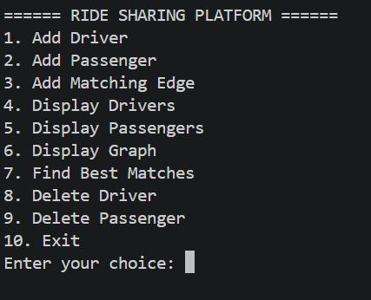
Demo Output :

Slide 9
Conclusion :
Use of data structures (arrays, structs, graphs)
Application of greedy algorithms
Real-world simulation of ride-sharing systems
It provides:
Efficient matching
Easy data management
Scalable design for future improvements

Slide 10


